Slide 1
Dipole Antenna
Shoubra Faculty of Engineering
Antenna
Dr / Sherief
Eng. Ibrahem Mohamed garrah

Slide 2
Basic Antenna Designs
There are many, many, many different antenna designs, each with different attributes (e.g., cost, size, gain, bandwidth, profile, etc.).
We will investigate a handful of the most popular and useful of these antenna designs.
A wire antenna provides a wide beamwidth in a small package with low cost. As a result, they are very popular!

Slide 3
The Wire Antenna
The simplest and perhaps most popular and prevalent antenna is the wire antenna.

Slide 4
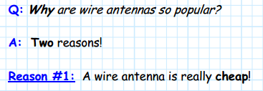
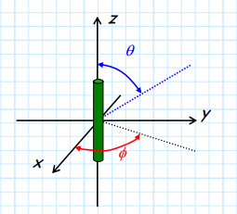
A wire antenna is simply a straight piece of wire. As a result, it is inexpensive to manufacture, a fact that makes it very popular for a plethora of consumer products
Q: How?? A: Say we orient our wire antenna along the z-axis. Consider carefully what happens if we were to rotate the wire around the z-axis:

Slide 5
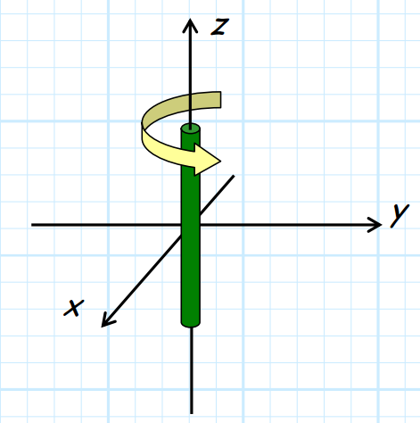
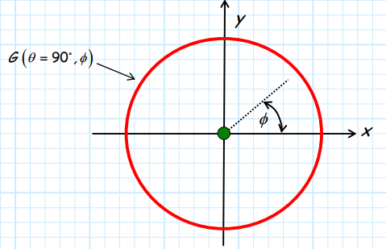
The wire is a circular cylinder, and as such
Possesses cylindrical symmetry. Rotating this
cylinder in azimuth does not change the
structure of the antenna one whit.
The wire cylinder has no preferred or unique
direction with respect to φ—every direction is the same! Thus, the gain pattern of an azimuthal cut
(i.e., G ,( )θ = 90D φ ) will be
a perfect circle!
In other words, a wire antenna will
radiate equally in allazimuth directions φ.

Slide 6
Q: Wait a second! Radiates equally in all directions?? That sounds like an isotropic radiator, but we know an isotropic radiator is impossible!
A: An isotropic radiator is impossible—meaning a wire antenna is of course not an isotropic radiator. Note that we found that a wire antenna radiates equally in all azimuth directions φ—it most definitely does not radiate uniformly in elevation direction θ.
!

Slide 7
Q: You say that this azimuthal symmetry is one reason while wire antennas are popular. Why is azimuthal symmetry a desirable trait?
A: For broadcasting and mobile applications, we do not know where the receivers are located (if we are transmitting), and we do not know where the transmitter is (if we are receiving).
As a result, we need to transmit (i.e., radiate) across all azimuthal directions, or receive equally well from any and all directions. Otherwise we might miss something!

Slide 8
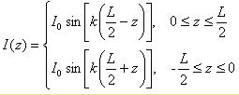
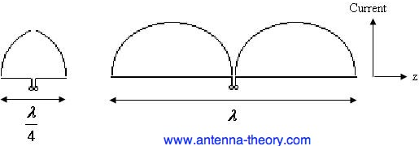
For a dipole antenna of length L oriented along the z-axis and centered at z=0, the current flows in the z-direction with amplitude which closely follows the following function:
The current distributions for the quarter-wavelength (left) and full-wavelength (right).
Before examining the fields radiated by a dipole antenna, consider the input impedance of a dipole as a function of its length, plotted in Figure 2 below. Note that the input impedance is specified as Z=R + jX, where R is the resistance and X is the reactance.

Slide 9
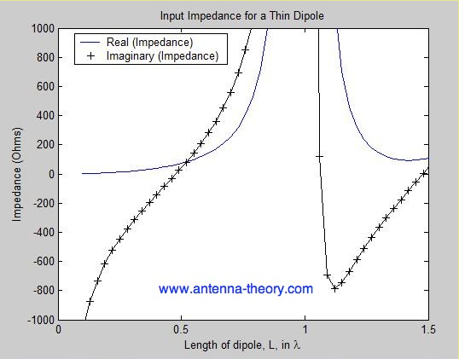
Note that for very small dipole antennas, the input impedance is capacitive, which means the impedance is dominated by a negative reactance value (and a relatively small real impedance or resistance). As the dipole gets larger, the input resistance increases, along with the reactance. At slightly less than 0.5 the antenna has zero imaginary component to the impedance (reactance X=0), and the antenna is said to be resonant.

Slide 10
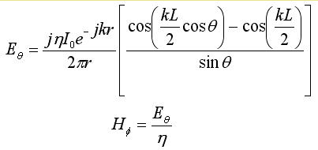
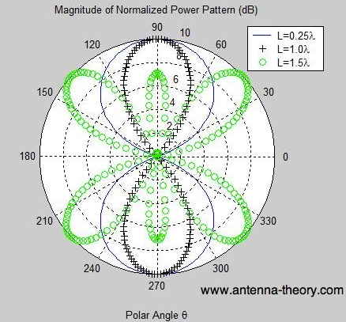
Radiation Patterns for Dipole Antennas
The far-fields from a dipole antenna of length L are given by:
The normalized radiation patterns
for dipole antennas of various
lengths are shown in Figure
The full-wavelength is more
directional than the shorter
quarter-wavelength dipole antenna.

Slide 11
The Half-Wave Dipole
With most microwave or electromagnetic devices (e.g., μ−wave circuits, antennas), the important structural characteristic is not its size—rather it is its size with respect to signal wavelength λ.
Instead of measuring the size of an antenna (for example) with respect to one meter (e.g., 1.5 meters or 0.6 meters) we measure its size with respect to one wavelength λ (e.g., 0.3 λ or 1.1 λ).

Slide 12
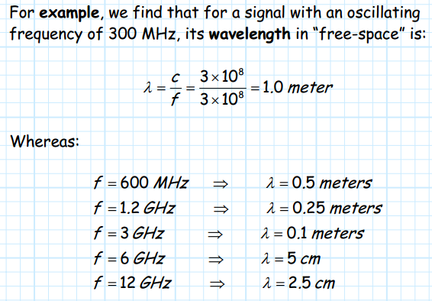
Note frequency increases, the value of one wavelength decreases.
So now, let’s consider again wire antennas. The size of a wire antenna is completely defined by its length l.
We can express this length in terms of: 1. meters (e.g., l = 0 6. m). We call this value the antenna’s physical length. 2. wavelengths (e.g., l = 0 2. λ). We call this value the antenna’s electrical length.

Slide 13
Of course the electrical length of the wire antenna depends on both its physical length and the frequency (wavelength) of the propagating wave it is transmitting/receiving.
For example, say an antenna with a physical length of l = 0.5m is transmitting a signal with wavelength λ = 0.25m. It is obvious (is it obvious to you?) that the electrical length of this antenna is l = 2.0λ.
With respect to wire antenna (both dipoles and monopoles), the important length with respect to fundamental antenna parameters (e.g., directivity, impedance) is its electrical length!

Slide 14
The most popular of all dipole antenna is one with an electrical length of one-half wavelength (i.e., l = λ/2). We call this antenna the half-wave dipole.
Q: What makes the half-wave dipole so popular?
A: One reason is that a half-wave dipole is relatively small. For example, at a frequency of 1 GHz, a half-wave dipole has a physical length of 15 cm. A small antenna has many obvious advantages (e.g., low weight, cost, and size).

Slide 15
Q: Well then, why don’t we simply make the antenna really small? Say an electrical length of l = 0.05λ or l = 0.00005λ ??
A: The problem with making a dipole extremely short is its impedance. As the electrical length of a dipole antenna shortens, two things happen to impedance ZA: 1. Its reactive component XA becomes very large and negative (i.e., capacitive). 2. Its radiation resistance becomes very small. In other words, a dipole with very small electrical length “looks” like a capacitor, and capacitors make bad antennas.

Slide 16
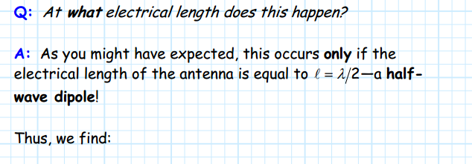
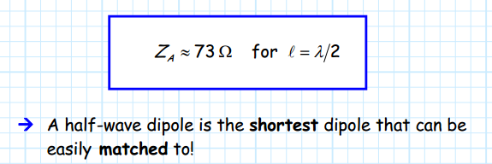
However, as we begin to increase the electrical length of an electrically short dipole, we find that its radiation resistance increases and its reactive component diminishes (becomes less negative).
If we increase the electrical length enough, we find that the reactive component will drop to zero (XA = 0), and its radiation resistance will have increased to a desirable Rr = 73 Ω .

Slide 17
In fact, half-wave dipoles do not (necessarily) require any sort of matching network, provided that characteristic impedance of the transmission line is also numerically equal to 73 Ω (i.e.,Z0 = 73 Ω).
Generally speaking, a transmission line of Z0 = 75 Ω is used for this purpose (its close enough!)
Q: So does a half-wave dipole a have a wide operating bandwidth?
A: Of course not!
Remember, as the signal frequency changes, the wavelength changes, and thus the electrical length changes.

Slide 18
The “design” or “operating” frequency of a half-wave dipole can be found from its physical length as:
If the signal frequency f is slightly greater or slightly less than the design frequency fo, then the antenna impedance will still approximately be ZA ≈ 73 Ω, and a “good” match will be maintained.

Slide 19
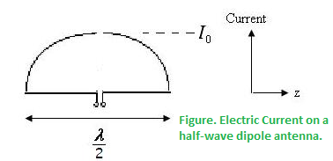
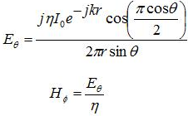
The half-wave dipole antenna is as you may expect, a simple half-wavelength wire fed at the center as shown in Figure:
The input impedance of the half-wavelength dipole antenna is given by Zin = 73 + j42.5 Ohms. The fields from the half-wave dipole antenna are given by:
The directivity of a half-wave dipole antenna is 1.64 (2.15 dB). The HPBW is 78 degrees.
it can be noted that by reducing the length slightly the antenna can become resonant. If the dipole's length is reduced to 0.48 wavelength, the input impedance of the antenna becomes Zin = 70 Ohms, with no reactive component.

Slide 20
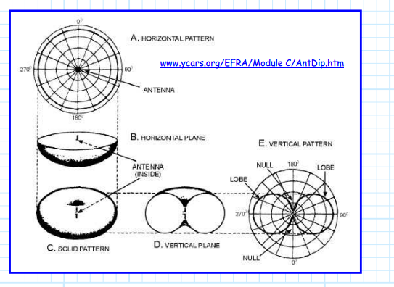
In the elevation plane, we find that the beam pattern is likewise
fairly wide, but with “nulls” occurring at θ = 0 (straight above the dipole) and at θ = π.

Slide 21
This doughnut shape is about as close as antenna can physically get to isotropic, and thus we find the directivity of the half-wave dipole is only slightly greater than one:

Slide 22
Note that:
1. This value of maximum directivity occurs in the direction θ = π/2 and for any and all azimuthal directions φ.
2. This value D0 is independent of design frequency—this directivity value is valid for any and all half-wave dipoles, regardless of their design frequency f0 . Since we know the directivity of a half-wave dipole, we can now determine its effective aperture:
Note that this value does change with design frequency!

Slide 23
As the wavelength increases (i.e., the frequency decreases), the effective aperture of a half-wave dipole will increase.
Q: Why is that?
A: Recall that as we lower the design frequency (i.e., increase the signal wavelength λ), the physical length of the antenna must increase.
* For example, a half-wave dipole for a signal with λ= 0.2m must have a physical length of l = 0.1m.
* Whereas, a half-wave dipole for a signal with λ= 2.0m must have a physical length of l = 1.0m.

Slide 24
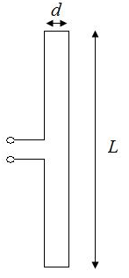
The Folded Dipole Antenna
A folded dipole is a dipole antenna with the ends folded back around and connected to each other, forming a loop
as shown in Figure.
Typically, the width d is much smaller than the length L.
you can imagine the folded dipole antenna as two parallel
short-circuited transmission lines of length L/2 (separated at
the midpoint by the feed in Figure ). So the impedance will be
a function of the impedance of a transmission line of length L/2.
Also, because the folded dipole is "folded" back on itself, the currents can reinforce each other instead of cancelling each other out, so the input impedance will also depend on the impedance of a dipole antenna of length L.

Slide 25
Letting Zd represent the impedance of a dipole antenna of length L and Zt represent the impedance of a transmission line impedance of length L/2, which is given by:
The input impedance ZA of the folded dipole is given by:

Slide 26
Thank you

